Slide 1
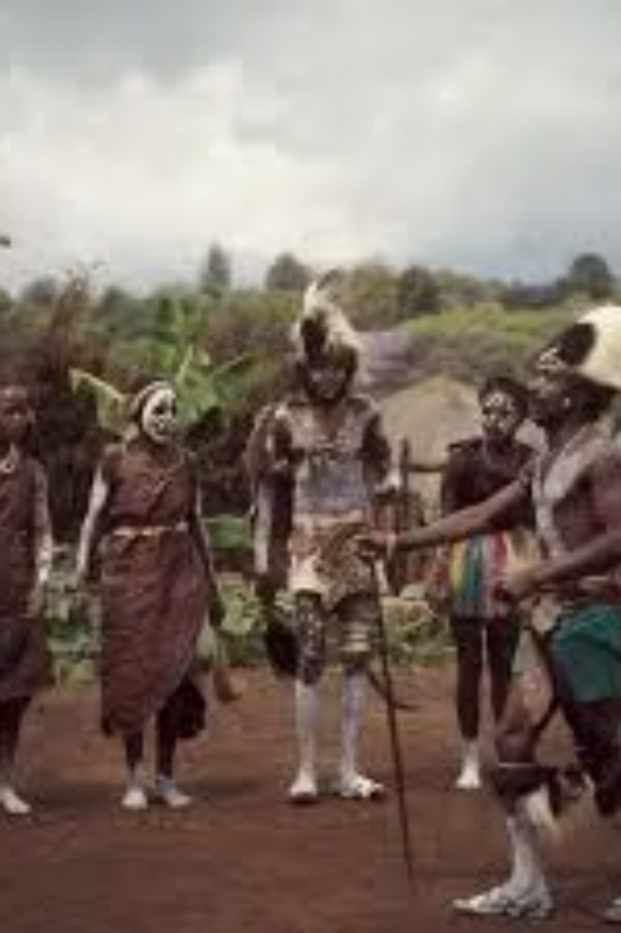
The Interface of Tradition and Technology in Kiambu
A Photographic Essay by Evans Mwaura

Slide 2
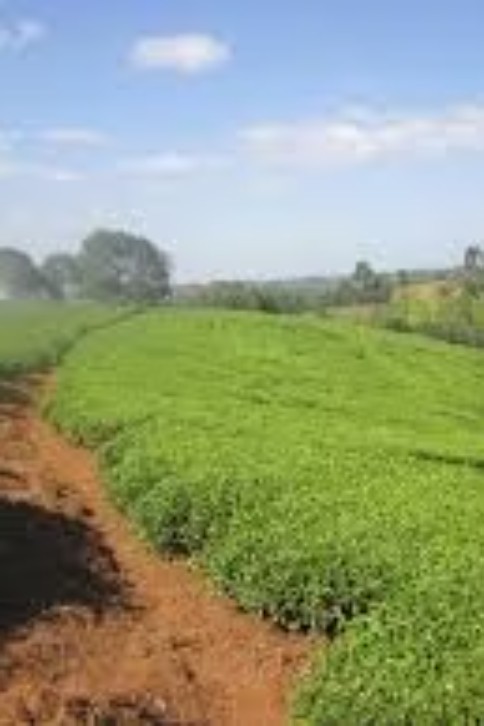
The Roots: Sustaining Generations
Agriculture has always been the bedrock of our community in Kiambu. For generations, the fertile lands have provided sustenance and livelihood, shaping our traditions, our work ethic, and our connection to the earth. This enduring practice, passed down from our ancestors, represents the deep roots of our heritage and the foundation upon which our society is built. The rhythm of planting, tending, and harvesting continues to define a significant part of our identity, reminding us of the timeless wisdom embedded in our agricultural practices.

Slide 3

The Hub: Commerce and Community
The open-air market in Ruiru is more than just a place of trade; it's a vibrant social hub where the pulse of the community can be felt. Here, traditional commerce thrives, teaching us invaluable lessons in resilience, negotiation, and community exchange. It's a place where stories are shared, relationships are forged, and the daily necessities of life are exchanged. This bustling environment, rich with the sights, sounds, and smells of local life, embodies the spirit of entrepreneurship and the enduring power of human connection that has characterized our society for centuries.

Slide 4

Digital Finance: Bridging the Gap
The advent of mobile money, particularly M-Pesa, has brought a profound transformation to even the most remote villages in Kiambu. This technological innovation has revolutionized how we handle money, seamlessly replacing traditional cash transactions with secure digital transfers. It has empowered individuals, facilitated small businesses, and connected communities to the broader economy. The M-Pesa agent shop, once an unfamiliar sight, is now a cornerstone of rural finance, symbolizing how technology can integrate with and enhance traditional ways of life, making financial services accessible to all.

Slide 5
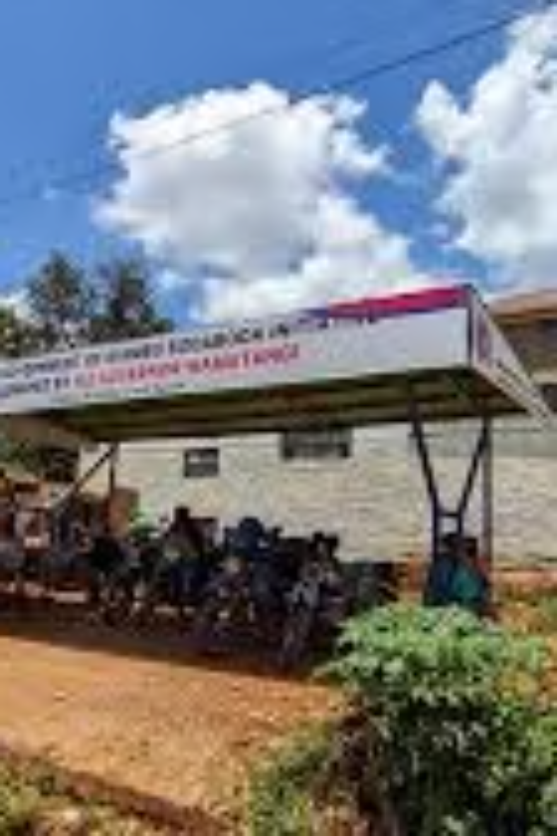
Navigation: Technology Driving Movement
The ubiquitous 'Bodaboda' riders, once relying solely on local knowledge, now harness the power of technology to navigate and thrive. GPS and ride-hailing applications have fundamentally transformed traditional transport, making journeys more efficient, safer, and accessible. This integration of digital tools into everyday movement highlights how technology is not just an external force but an intrinsic part of our daily lives, optimizing our ability to connect, commute, and conduct business across Kiambu. It's a testament to how innovation can enhance even the most established forms of service.

Slide 6

The Shift: Education for a Digital Future
Education stands as the crucial bridge between our agrarian past and the promising digital future. The image of a student, perhaps holding a tablet or an advanced textbook, encapsulates this pivotal shift. Our educational institutions are evolving to equip the next generation with the skills and knowledge necessary to navigate a technologically advanced world. This commitment to learning ensures that while we honor our traditions, we are also actively preparing our youth to innovate, lead, and contribute meaningfully to a globalized, digital economy, fostering a future where both heritage and progress coexist.

Slide 7

The Builder: Powering the Next Economy
As a developer, I am actively engaged in writing the scripts and crafting the applications that will power the next generation of our economy. This act of creation, translating ideas into functional code, is a direct contribution to the technological advancement of our community. It represents the hands-on effort required to build the digital infrastructure that supports innovation, creates new opportunities, and drives economic growth. This work is not just about technology; it's about building a future where our traditions are respected, and our potential is fully realized through the power of digital innovation.

Slide 8

Connection: Uniting the Nyumba
Technology, particularly mobile communication, plays a vital role in keeping the family unit, or 'Nyumba,' connected, even when members migrate to urban centers for work or education. The sight of an elderly person speaking on a mobile phone is a powerful symbol of this enduring connection. It bridges geographical distances, allowing families to maintain strong bonds, share news, and offer support across generations. This digital lifeline ensures that the warmth and solidarity of the Nyumba remain intact, reinforcing the importance of family in our culture despite the changes brought by modernization.

Slide 9
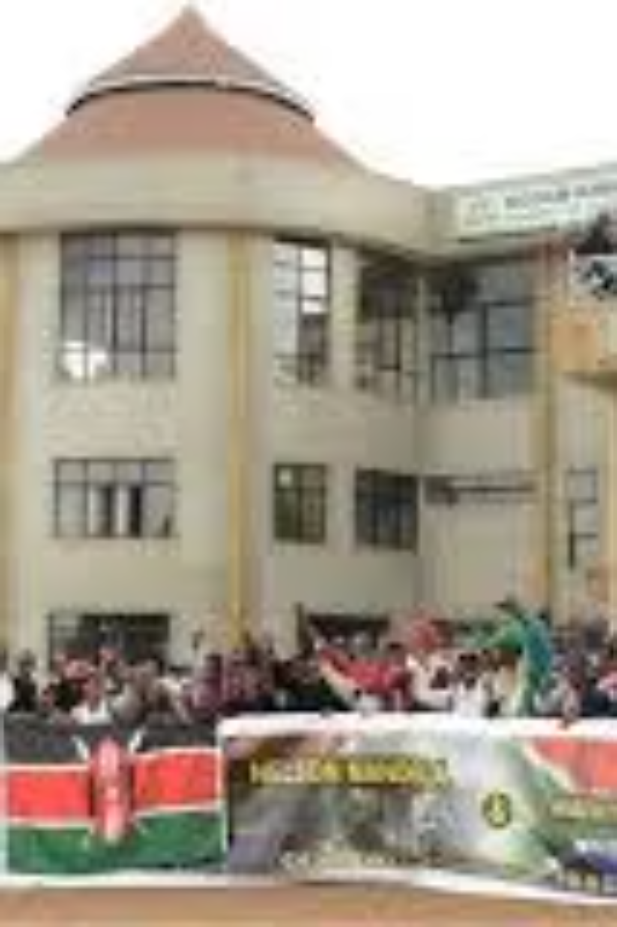
The Forge: Refining Curiosity into Skill
Dedan Kimathi University of Technology Center stands as a beacon of innovation and learning, a true forge where raw curiosity is meticulously refined into professional skill. This institution is instrumental in shaping the minds that will lead our technological future. It provides the environment, resources, and expert guidance necessary for students to develop critical thinking, problem-solving abilities, and specialized technical expertise. It's a place where academic rigor meets practical application, ensuring that the next generation of leaders and innovators are well-prepared to contribute to Kiambu's growth and beyond.

Slide 10

Horizons: Gratitude and Innovation
As the sun sets over Ruiru, casting a warm glow across the landscape, I look towards the horizon with a profound sense of gratitude for my roots and an immense excitement for the innovation yet to come. This view encapsulates the journey from tradition to technology, a path we are navigating with resilience and vision. It's a reminder that while we cherish our heritage, we are also actively building a future that embraces progress, creativity, and new possibilities. The blend of natural beauty and emerging urban development symbolizes a harmonious future where tradition and technology coalesce to create a vibrant and prosperous Kiambu.

